Slide 1
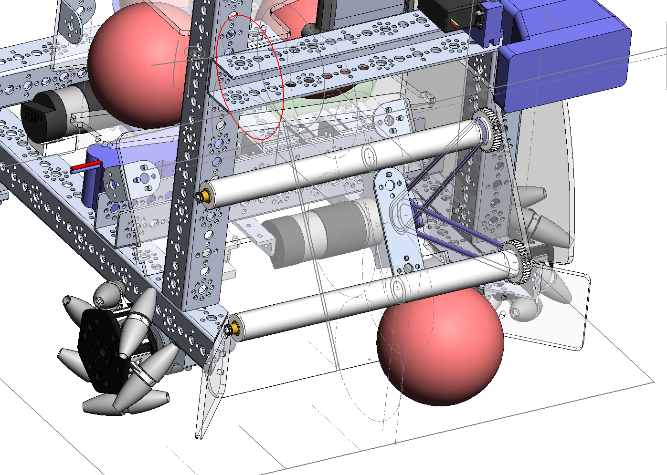
These belts too loose.
This motor mount hits
the drive motor below it.
Figure 1
3.05.2017
This plate not mounted in the right spot.

Slide 2
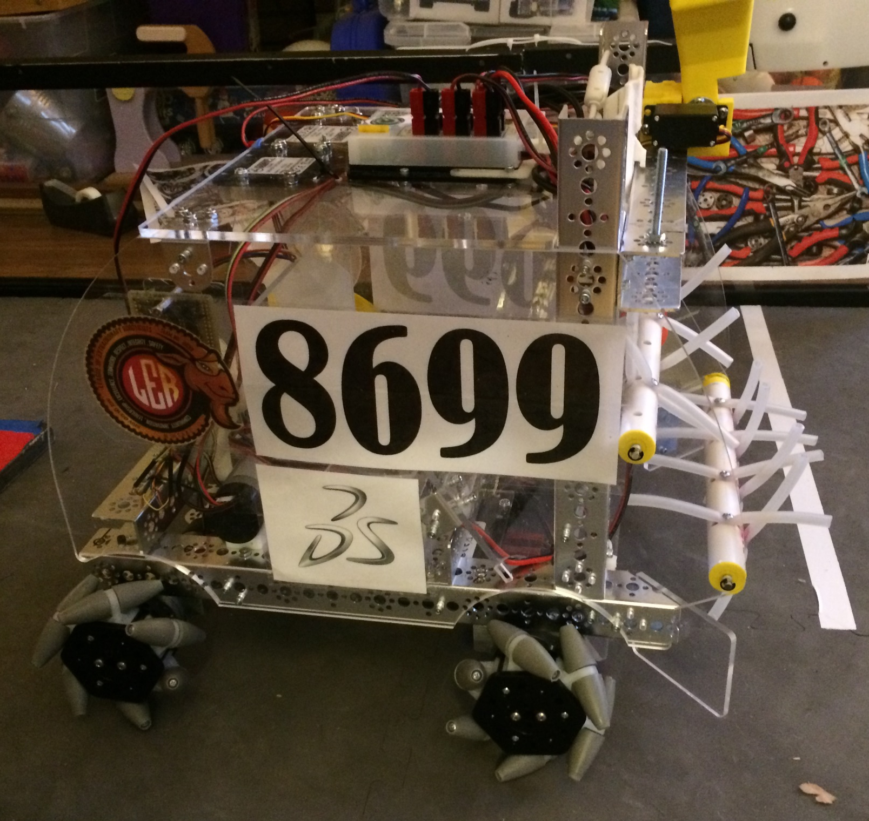
Sweepers
Figure 2
3.05.2017

Slide 3
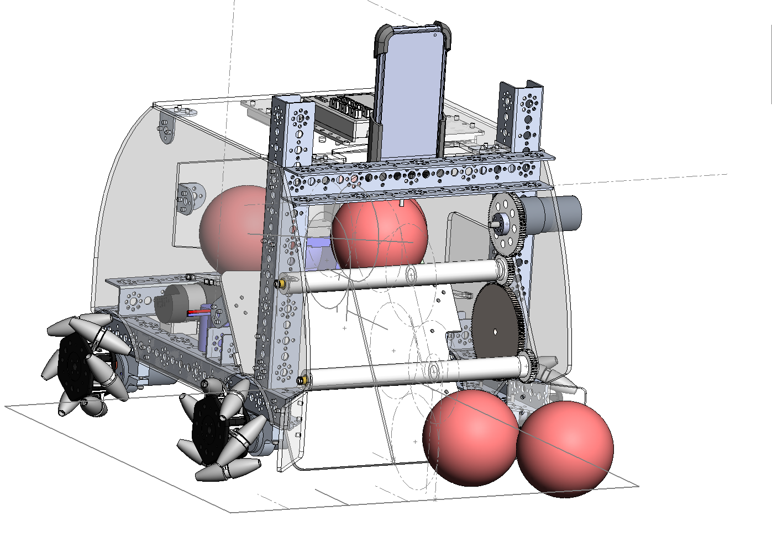
Motor new location
Replace belts with
Gears.
Figure 3
3.05.2017

Slide 4
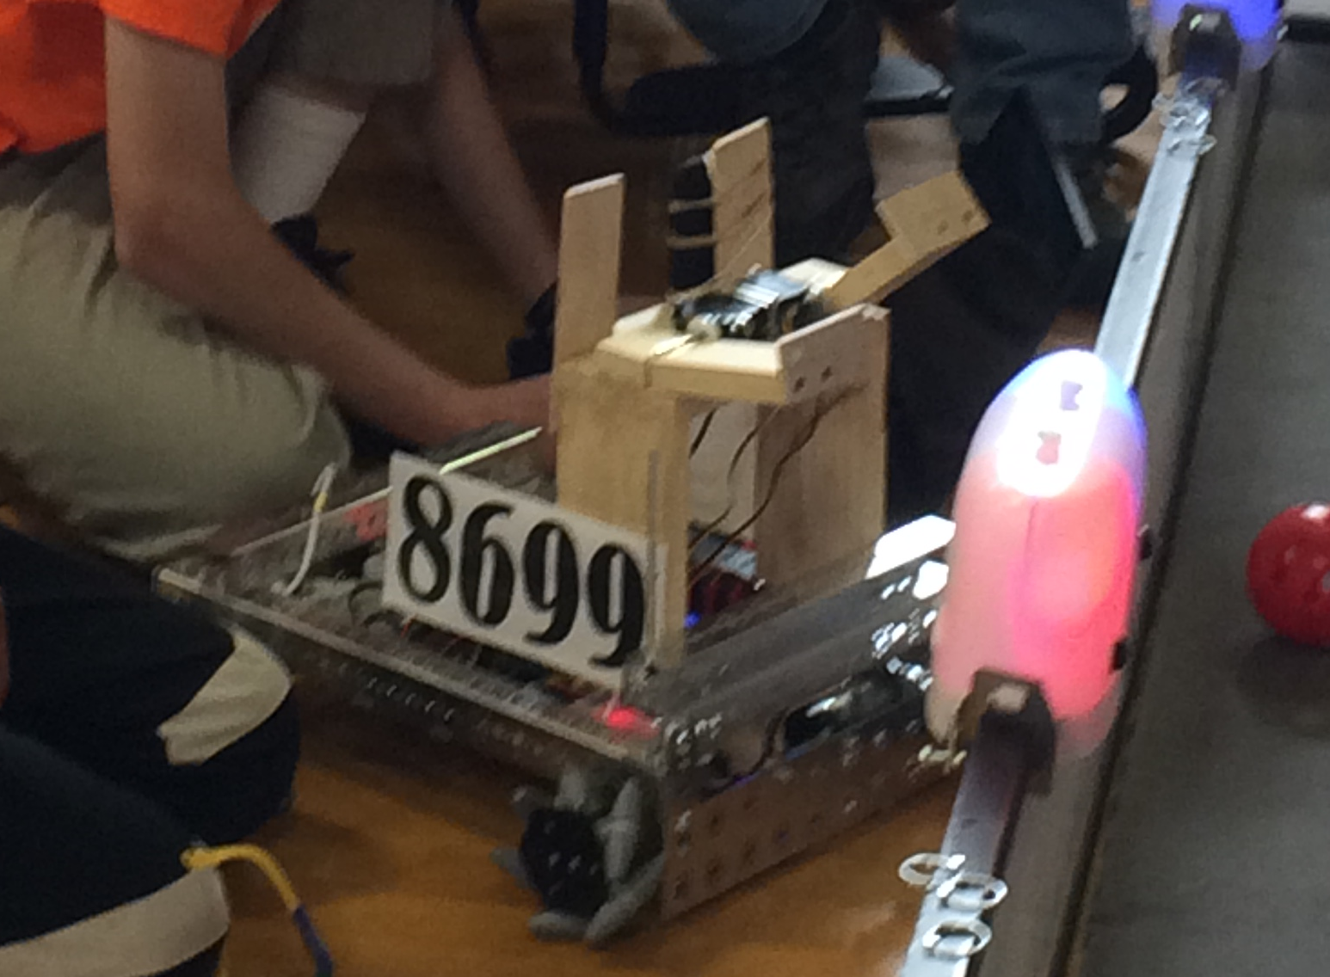
Two Beacon Pushers
Mecanum Wheels
Figure 1
12.04.2016

Slide 5
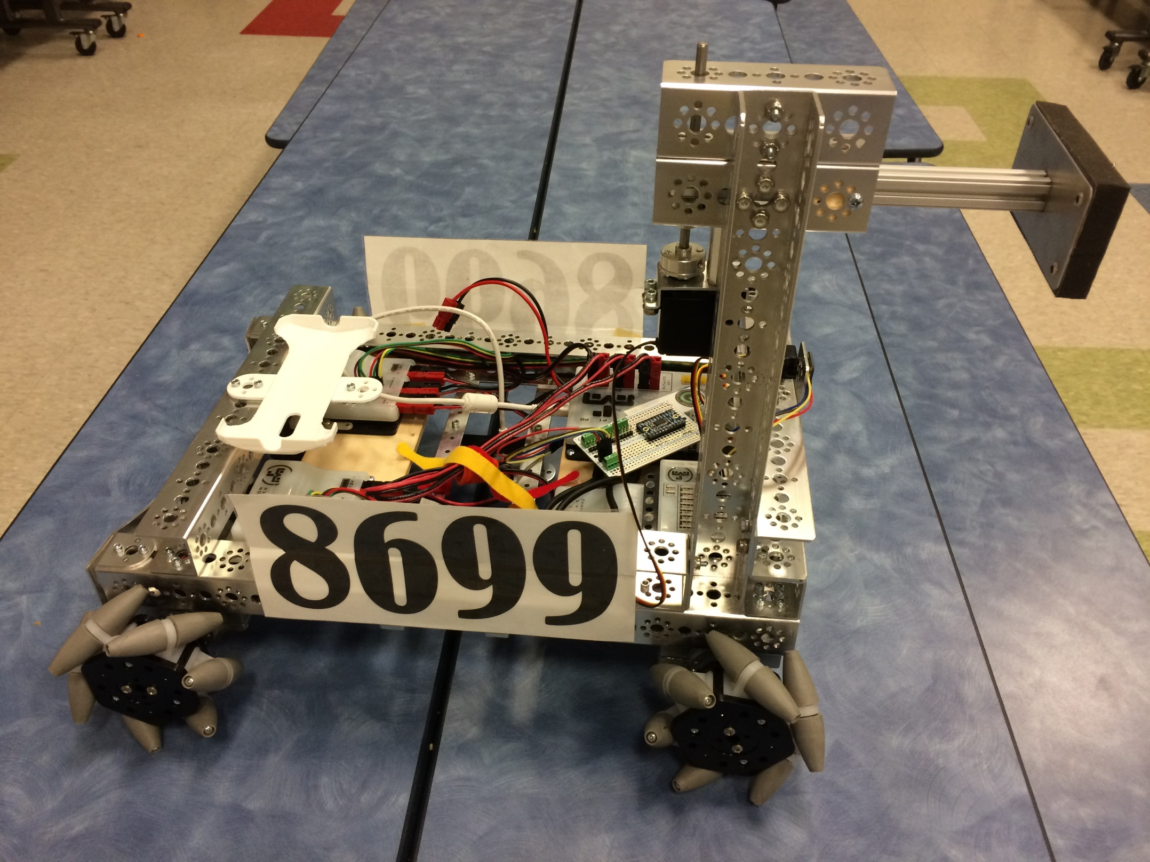
One Beacon Pusher – vertical axis
Mecanum Wheels
Figure 1
1.21.2017

Slide 6
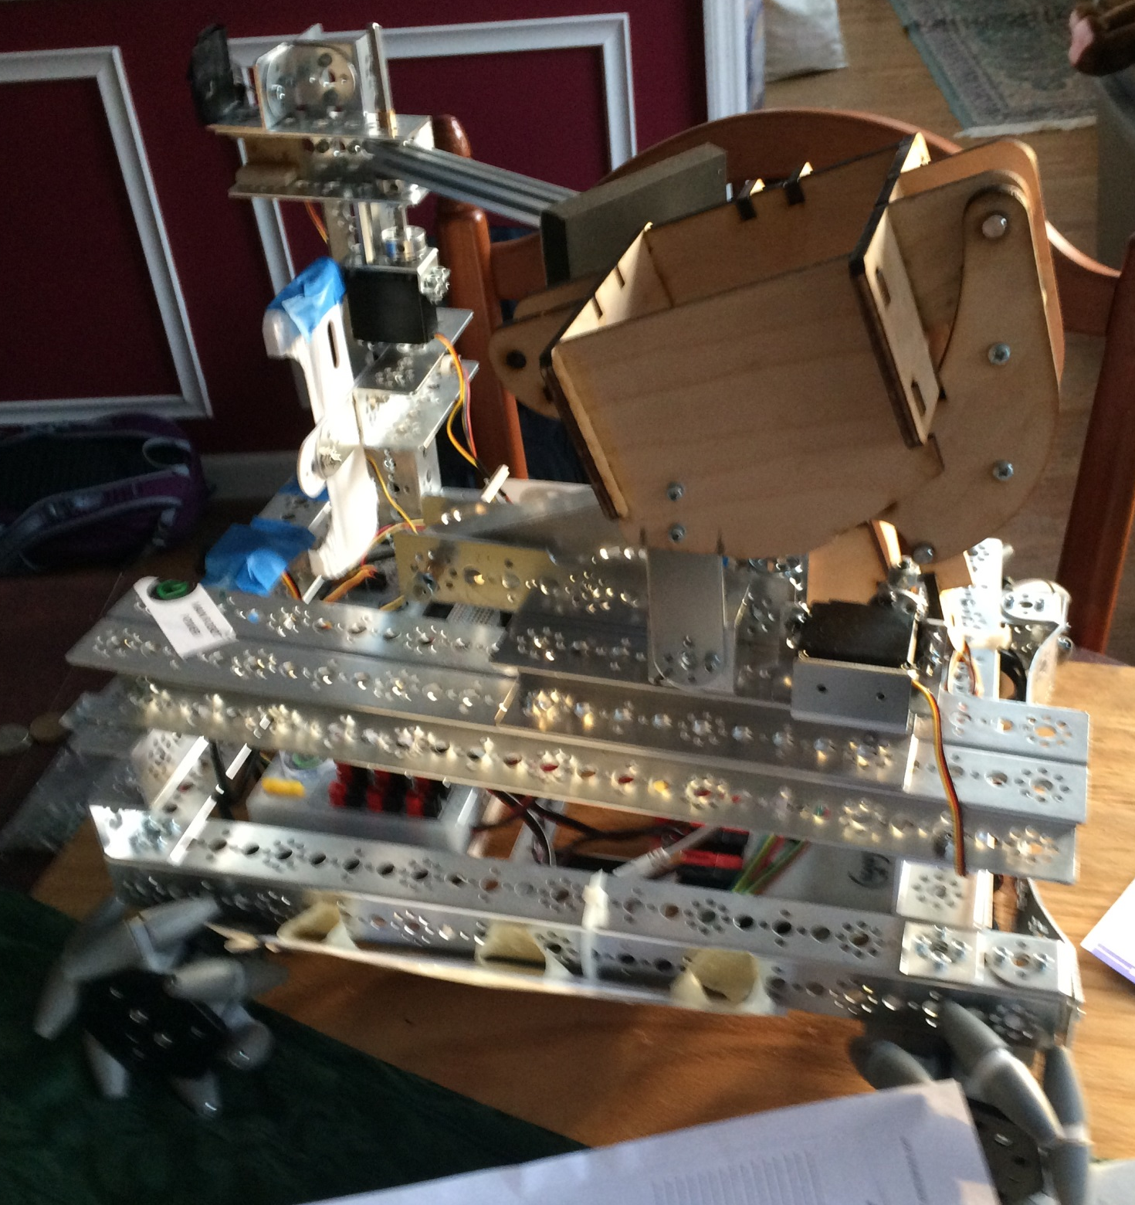
“Single Ball” Shooter
One Beacon Pusher – vertical axis
Figure 1
2.04.2017
Mecanum Wheels

Slide 7
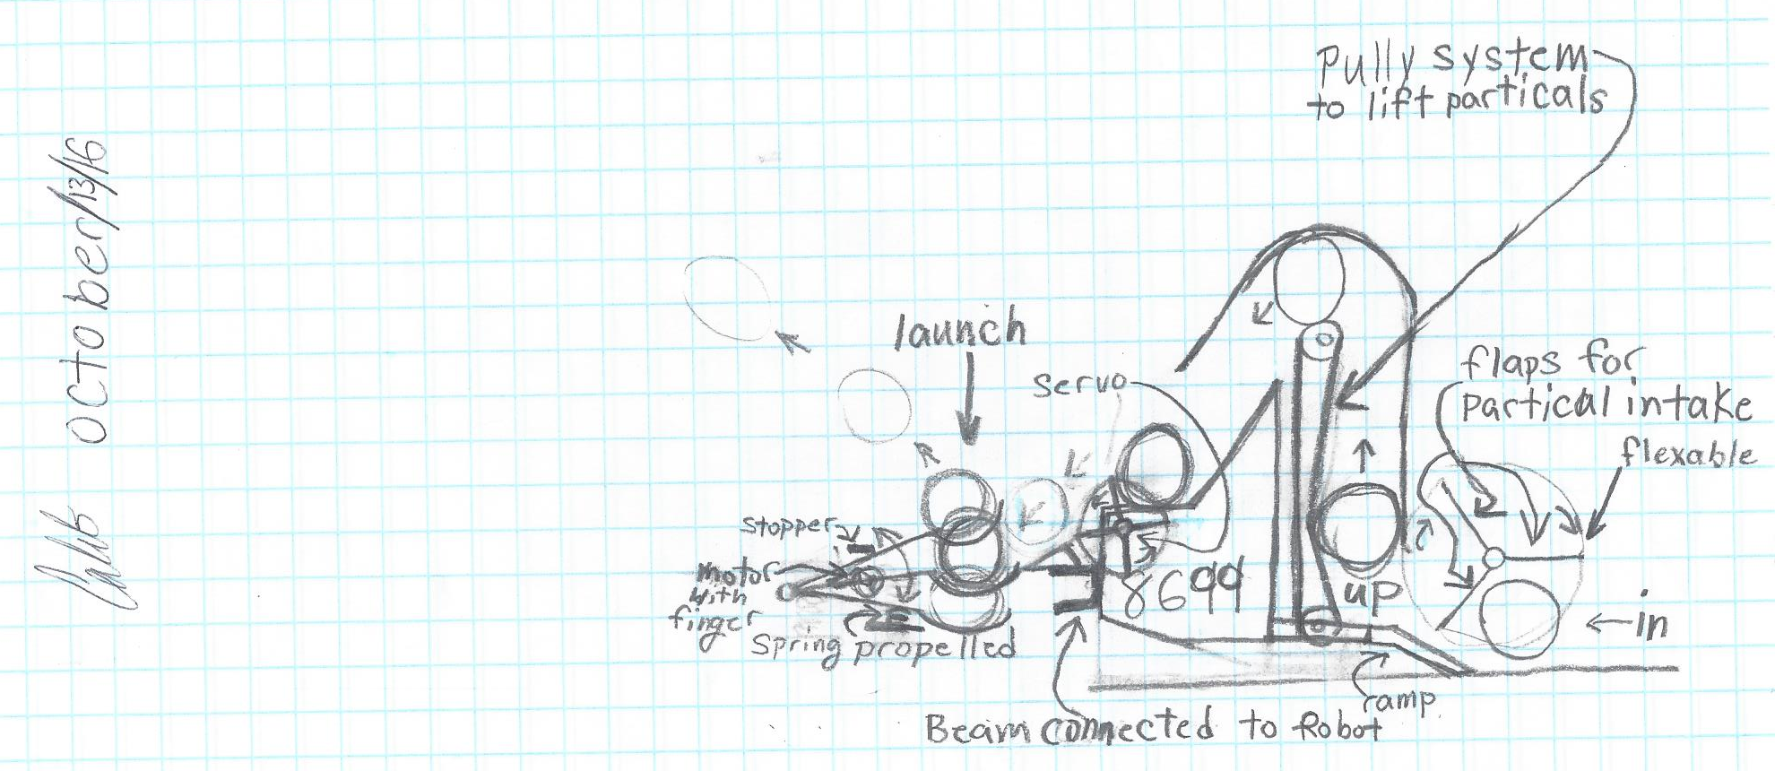
Figure 1
10.13.2016
One Beacon Pusher – vertical axis
“Single Ball” Shooter
Mecanum Wheels

Slide 8
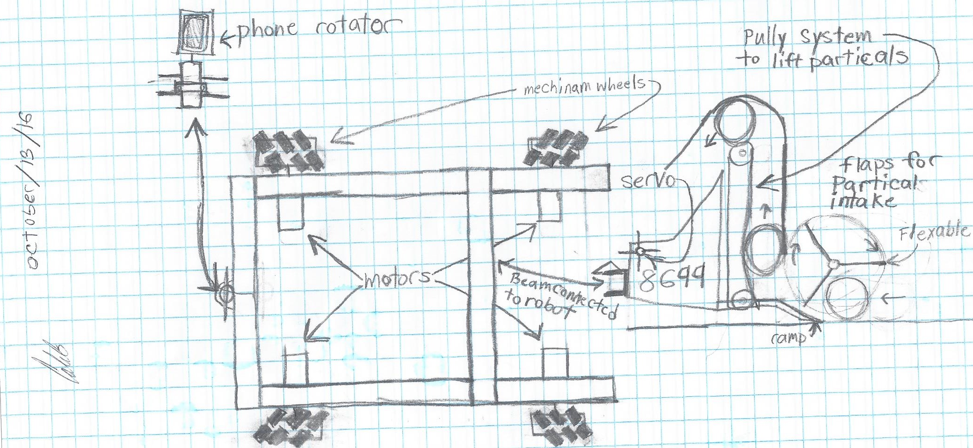
Figure 2
10.13.2016
One Beacon Pusher – vertical axis
“Single Ball” Shooter
Mecanum Wheels

Slide 9
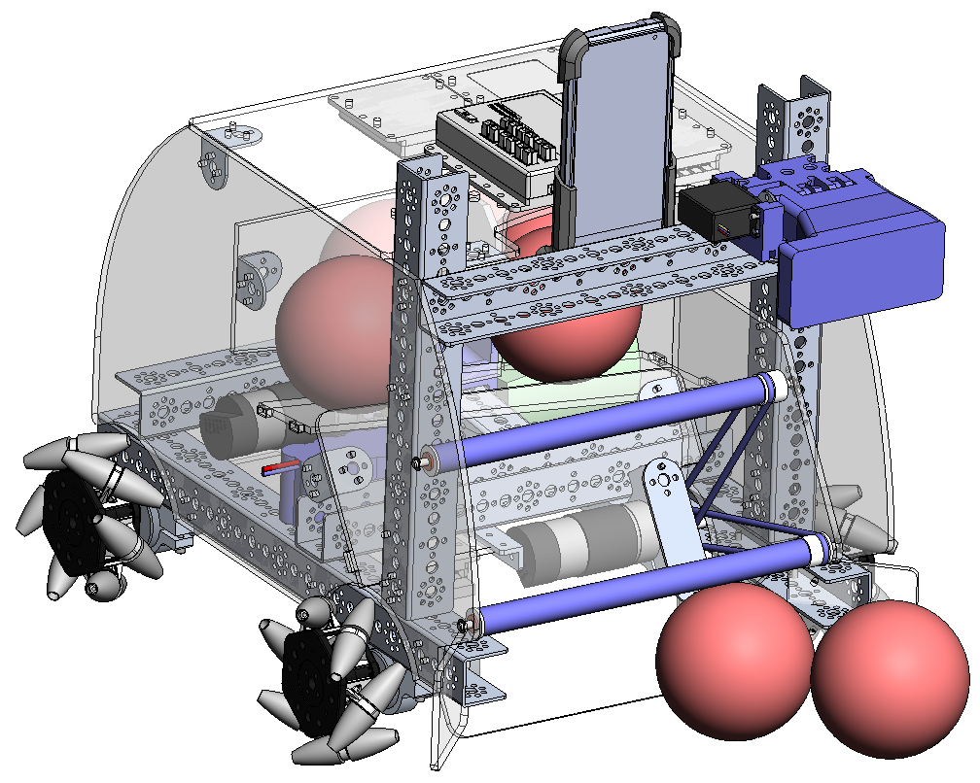
Phone mount so cameras can be used
Beacon Pusher
Option to add another
Ball Feed Sweep - O Ring pulley driven, with Surgical tubing sweep fingers
Mecanum Wheels
Figure 3
1.29.2017

Slide 10
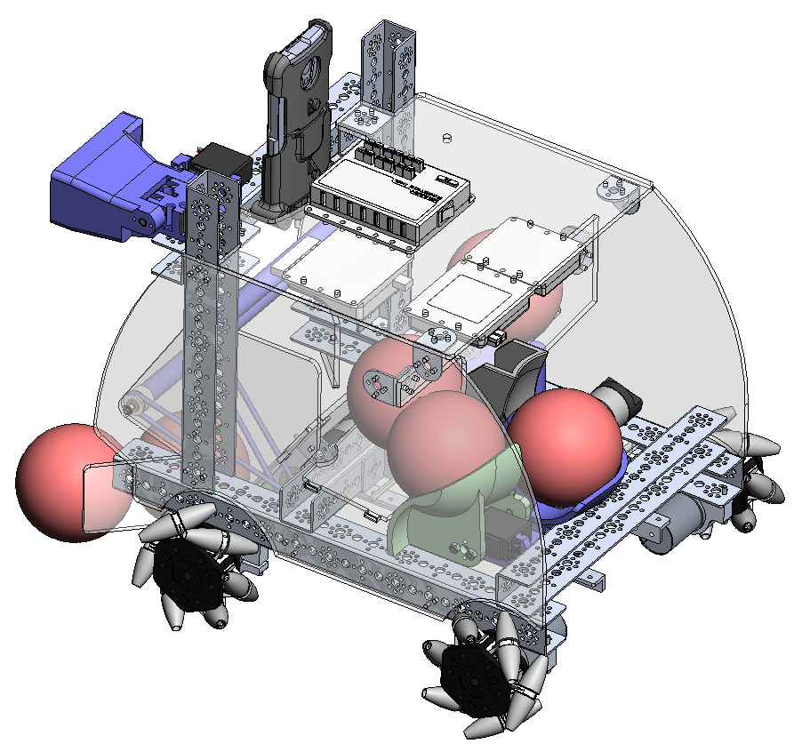
Relocate electronics to top and bottom plates.
Shooter and re-loader
Figure 4
1.29.2017

Slide 11
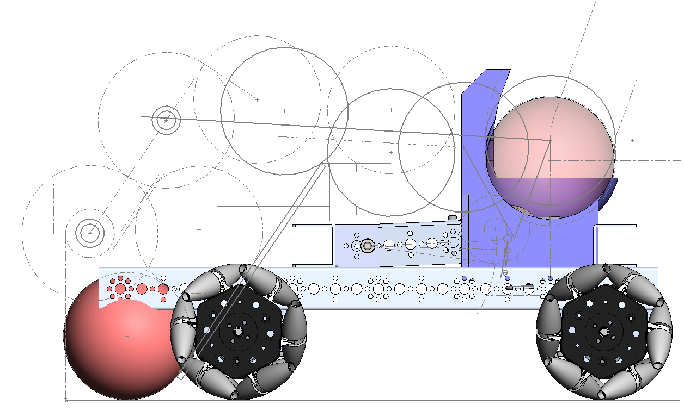
Sweepers – 4 inch dia
Particles route
Figure 5
1.29.2017

Slide 12
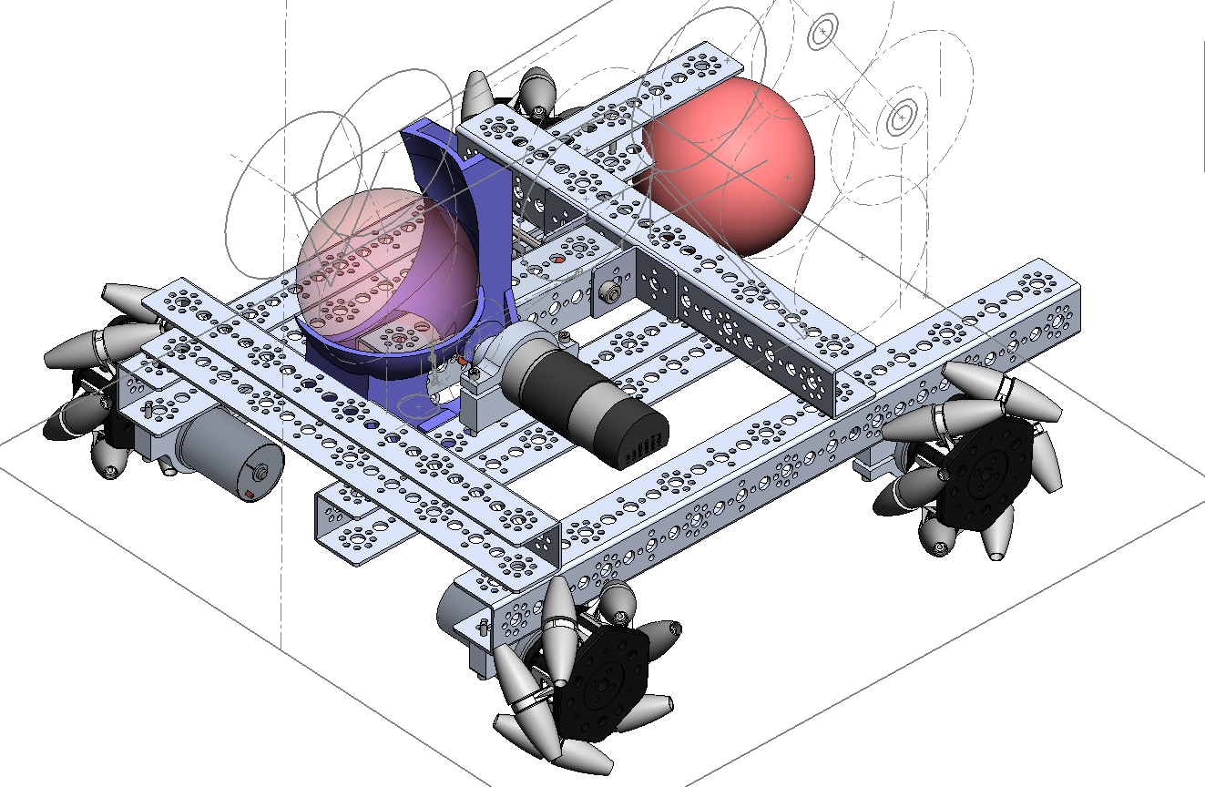
Spring loaded lever
Shooter –
Motor with CAM pushes down and releases spring loaded lever.
Figure 6
1.29.2017

Slide 13
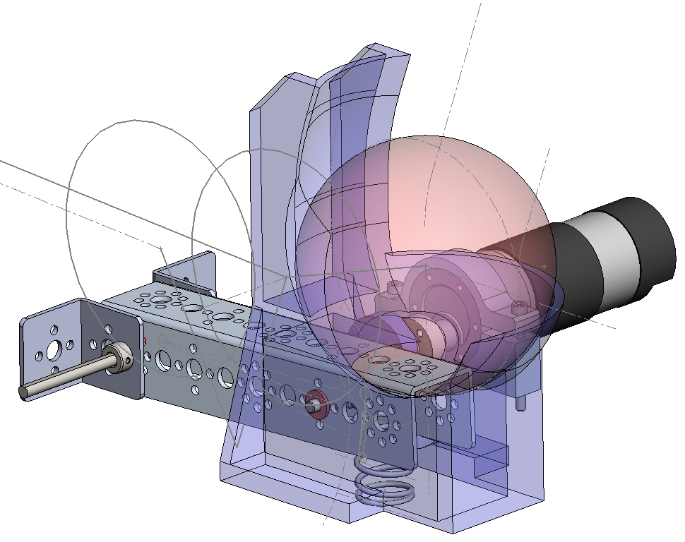
Shooter –
Motor with CAM pushes down and releases spring loaded lever.
Spring loaded lever
Figure 7
1.29.2017

Slide 14
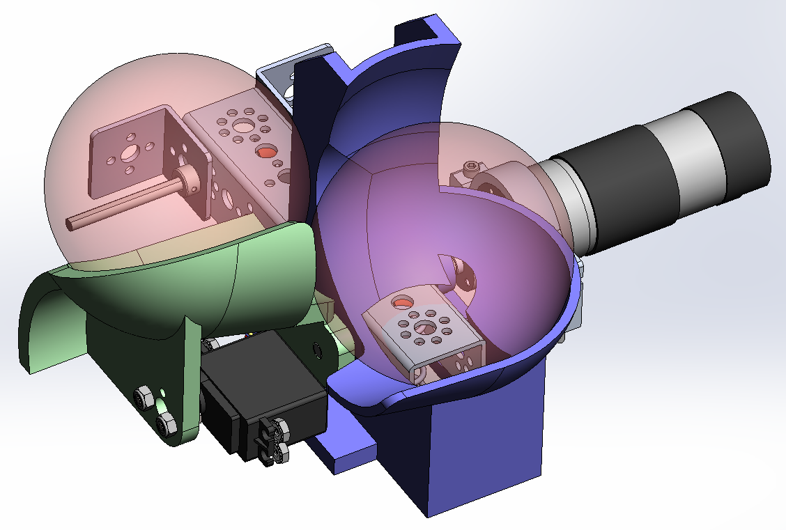
Re-loader
Figure 8
1.29.2017

